Slide 1
Paper or Plastic?
Or neither?
By Brianne Eatchel

Slide 2
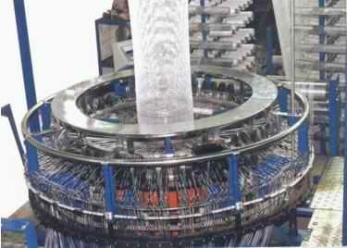

Slide 3


Slide 4
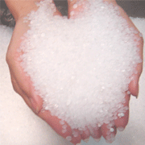

Slide 5
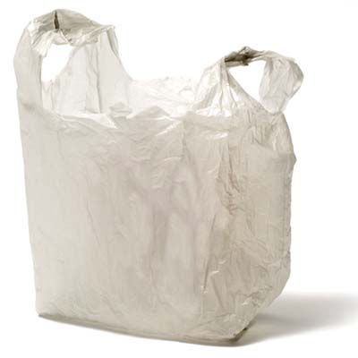

Slide 6
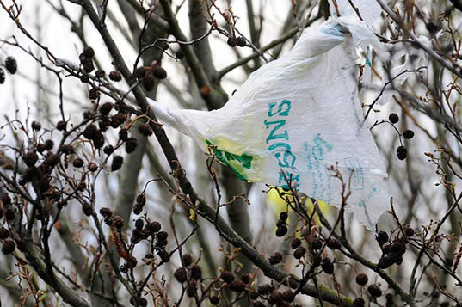

Slide 7
