Slide 1
Snowboarding- Then and Now
By
Brianne Eatchel

Slide 2
Snowboarding: Overview
Snowboarding began sometime within the years of 1960-1962. It originated from altering and adding to the sports of skiing, surfing, and skateboarding. It involves descent, usually down a mountain, by carving on each side of a wooden board, attached to a person’s feet that are equipped with special boots and bindings that are tightly attached to the snowboard on snow.

Slide 3
The Beginning of Snowboarding
Snowboarding, as previously mentioned, was invented in the early 1960s, but truly became a sport when Jake Burton Carpenter started manufacturing the first commercial snowboards in 1977 in Burlington, Vermont. Preceding is an article I previously submitted to a researching class, depicting facts about Carpenter and the early workings of Burton Snowboarding.

Slide 4
Burton Snowboarding Article

Slide 5
Snowboarding In the Olympics
Snowboarding was not widely accepted as a mountain winter sport until 1977, and was not allowed into the Winter Olympics until 1998- a whopping 36 years after the sport was first brought to light. It is now one of the top three watched sports in the Winter Olympics, along with speed skating and short track. Preceding this information is a chart displaying all of the Winter Olympic Sports.

Slide 6
Winter Olympic Sports

Slide 7
Chart of Events

Slide 8
Graph of 7 Most Popular Snowsports

Slide 9
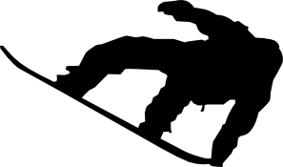
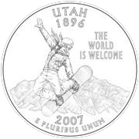
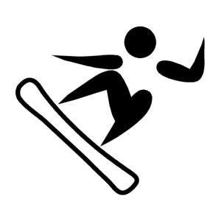
Snowboarding Imagery
A silhouette of a snowboarder,
Doing a tailgrab- a common trick
In Snowboarding
A proposed Utah Quarter for the
National mint, which was disregarded
And taken place by the beehive.
Clip art of the official
Snowboard symbol for the
Vancouver Winter Olympics

Slide 10
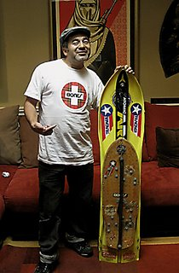
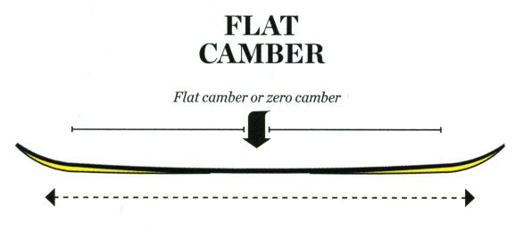
Snowboard Technology
In the more advanced technology that has been developed by Burton and other product distributors, advantages that come with new designs have benefited the modern snowboarder everywhere. In the original snowboards produced by Burton, as seen below, the technology was minimal- what the snowboarding industry describes as being a ‘flat kick’ or ‘flat camber’ snowboard, or the shape being that the entire snowboard lays flush to the ground, only ‘kicking’ or rising up towards the end.

Slide 11
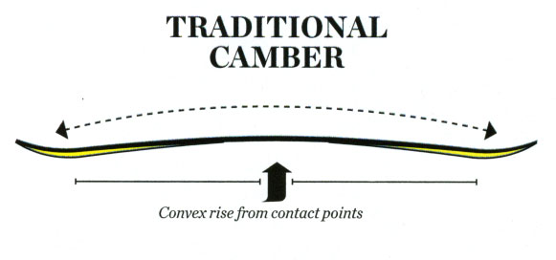
Technology cont.
In new technology that was developed and tested in the last decade, we see what is called ‘camber’ (or lifted in between the bindings and touching at the ends) this, up until 2008, was the most commonly purchased snowboard.

Slide 12
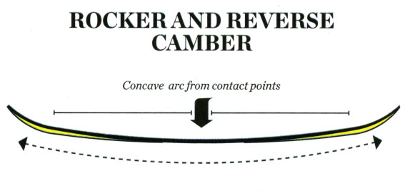
Technology cont.
Reverse camber, or commonly known as rocker, banana, or chillydog, is a new take on the old design- used for jibbing (riding downslope on rails, ride boxes, and jumps) and is becoming very popular in the snowboarding community.

Slide 13
References
Snowboarding Overview (history)
http://en.wikipedia.org/wiki/Snowboarding
Snowboarding Images (camber, rocker, flat) http://snowboarding.transworld.net/1000106102/featuresobf/snowboard-camber-explained/
Jake Burton Carpenter (Burton)
http://en.wikipedia.org/wiki/Burton_snowboards
Winter Olympic Snowboarding info and images
http://en.wikipedia.org/wiki/Snowboarding_at_the_Winter_Olympics
Snowboarding Technology
http://snowboarding.transworld.net/1000106102/featuresobf/snowboard-camber-explained/
Olympic Sport (Winter) Popularity
http://www.suite101.com/content/winter-olympic-games-a193495

