Slide 1
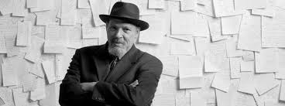
Fences
August Wilson

Slide 2
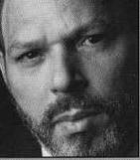
August Wilson
Born April 27, 1945 - October 2, 2005
An American Playwright whose work included a series of ten plays, The Pittsburgh Cycle, for which he received two Pulitzer Prizes for Drama.
Each play is set in a different decade, depicting the comic and tragic aspects of the African-American Experience in the twentieth century.
Many scenes in his plays are based on his life experience.

Slide 3
Author’s Background & Grounds for Motive
As an author, he went by stage name August Wilson. Wilson was born Frederick August Kittel in Pittsburgh, PA to a German father and an African American mother in 1945. His father drifted in and out of his family. His mother and a stepfather, David Bedford, mostly raised Wilson. When Wilson was sixteen, he was accused of plagiarism at school when he wrote a sophisticated paper that was believed to be above his skill level. When Wilson's principal would not recognize the validity of Wilson's work, she suspended him and later ignored his attempts to come back to school. Wilson soon dropped out and educated himself at the local library, reading everything he could find. In the 1960's, Wilson steeped himself in the black power movement while he worked on his poetry and short stories.

Slide 4
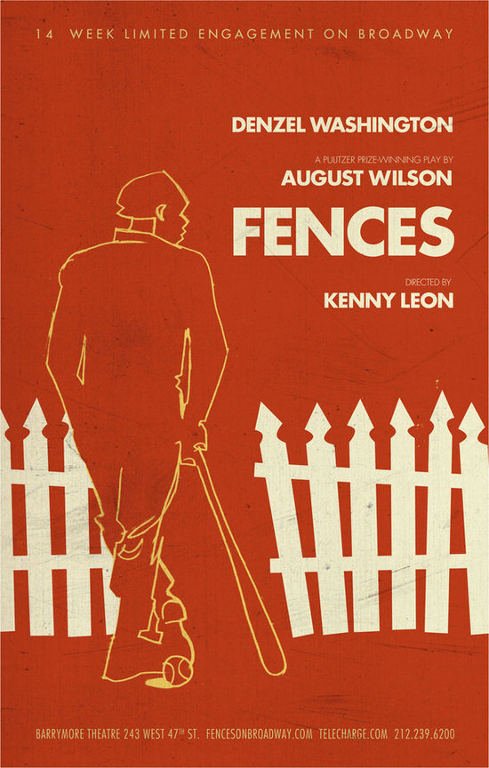
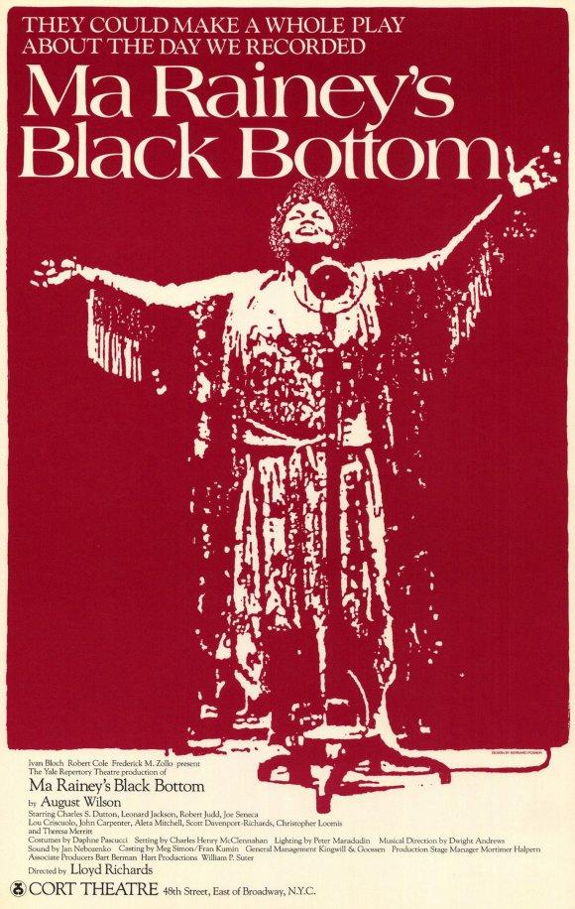
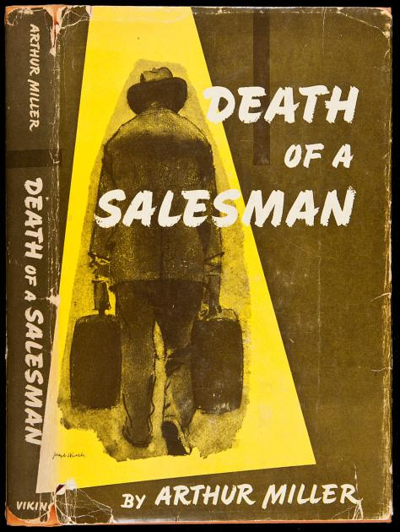

Writing Fences

Slide 5
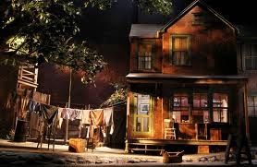
Fences

Slide 6
Setting
1957 Pittsburgh, Pennsylvania
Setting of “Fences” is the front of the Maxson home
  Two old chairs sit on the run-down porch.
  The Maxon’s yard consists of dirt.
  The 2 story home was purchased by money that was not rightfully Troy’s to spend.
  Troy is building a fence that isn’t finished.

Slide 7
Brief Overview of Events in “Fences”
Act One: Four Scenes
First Line - Bono: “Troy, you ought to stop that lying!”
Troy and buddy Bono
Troy Maxson wants to be a garbage truck driver
A possible affair is suggested
Troy reflects on past experiences (playing baseball, stealing to survive, accidental murder, prison)
Lyons needs money again but promises to pay Troy back
Cory wants to play sports
Troy is allowed to be a garbage truck driver
A fight over football becomes “strike one” for Cory

Slide 8
Brief Overview of Events in “Fences”
Act Two: Five Scenes
Gabriel, Troy’s brother injured in the war, needs to be bailed out of jail
Troy admits to his affair with now pregnant Alberta
Cory and Troy fight and Cory gets “strike two”
Gabriel is committed to an asylum
Cory gets “strike three”
Alberta dies in childbirth
Rose agrees to raise new baby Raynell but will no longer act as Troy’s wife
8 years later…Troy has died of a heart attack
Cory comes home
Raynell and Cory sing
Gabriel blows his trumpet but no sound comes out
Last Line - Gabriel: “That’s the way that go!”

Slide 9
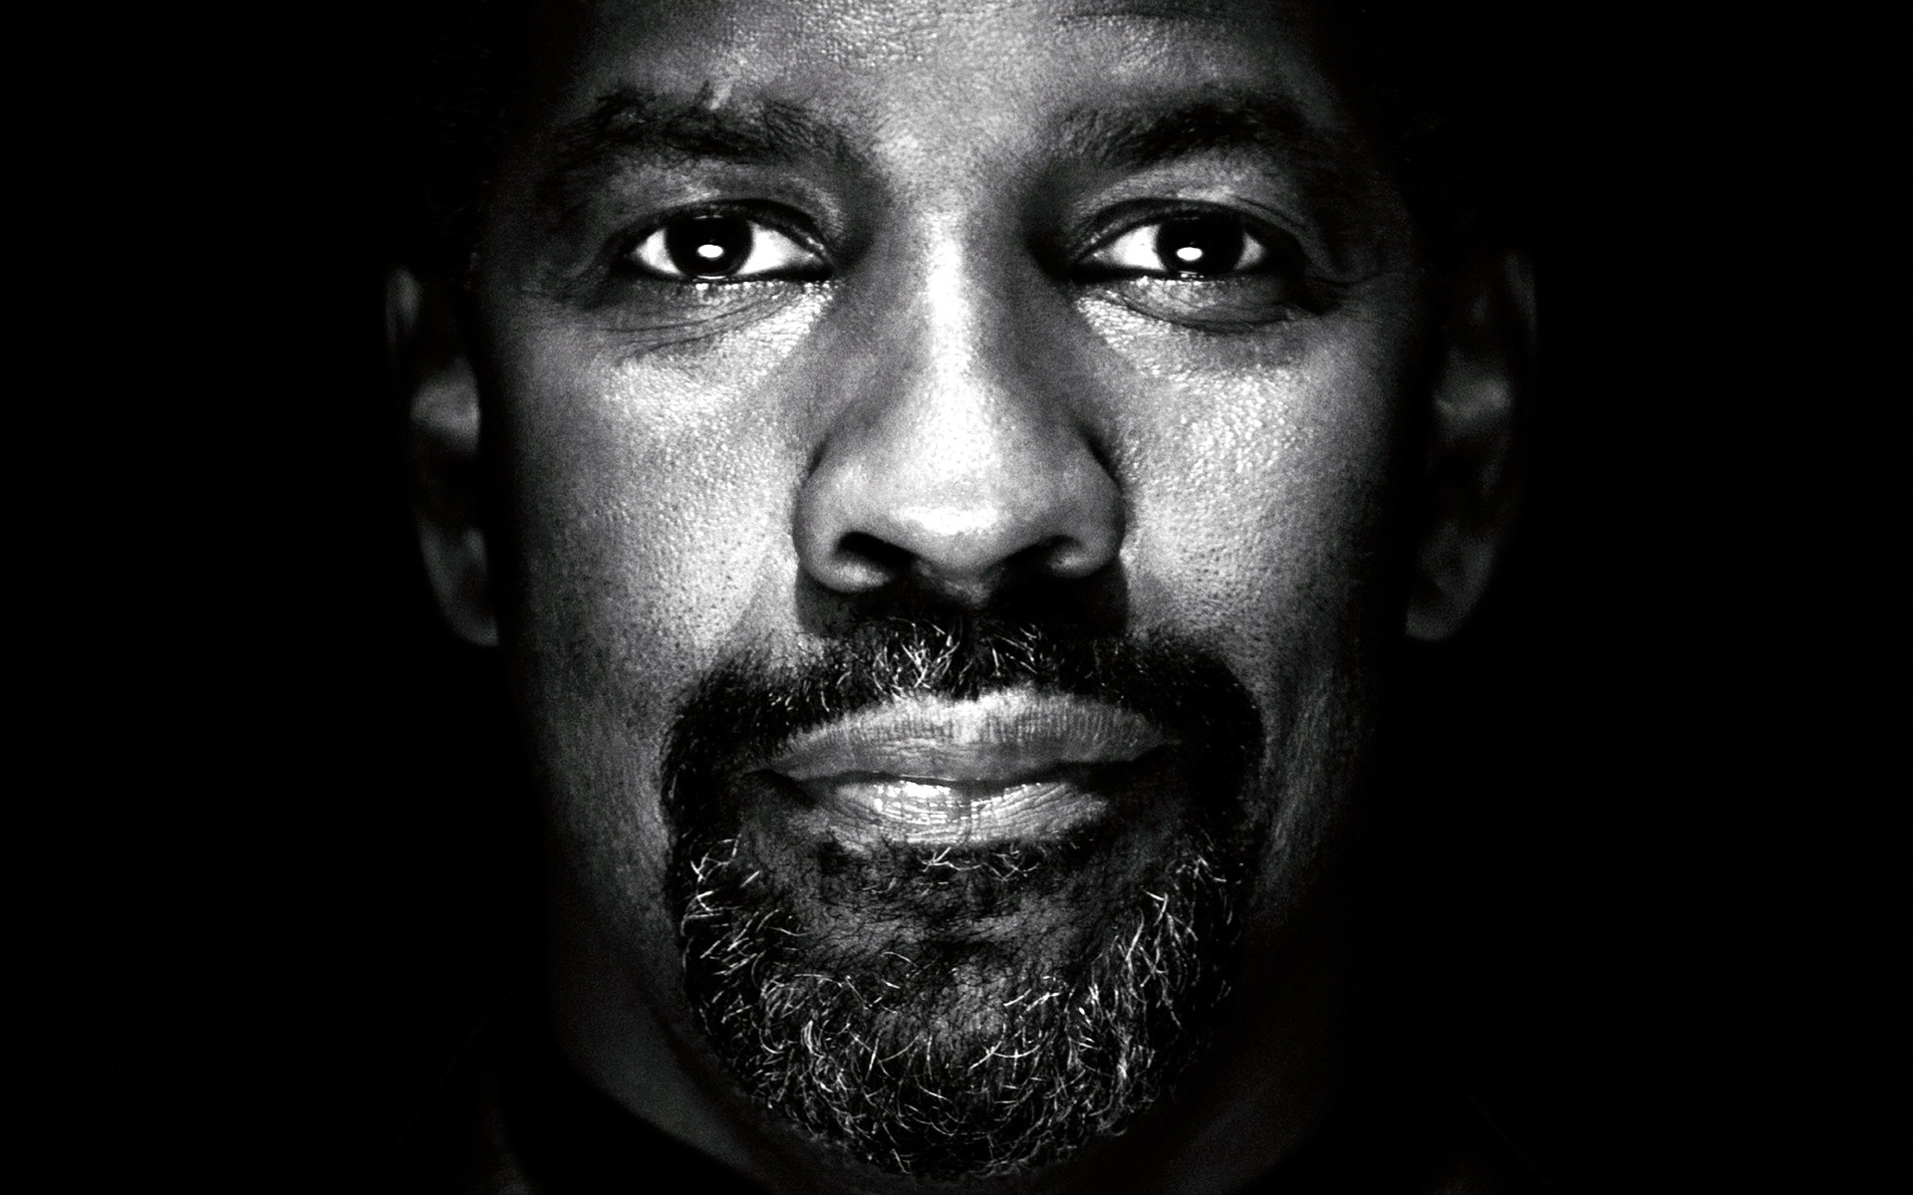
Characters: Troy Maxson
Hypocrisy
  Responsibility vs his affair
  Tragic hero
Self-created illusions
  White men will only pay for a ‘trade’
  Interaction with Alberta
  Untouchable by death
  Instigates conflict
The name Maxson
  Mason-Dixon Line
  Line between ideas / family

Slide 10
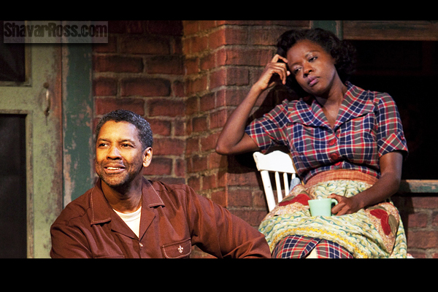
Characters: Rose Maxson
The name Rose
  Nurturing
  Loving
  Kindness
Compassion
  Judge of character
  Understanding
Hope
  For the future
  Redemption

Slide 11
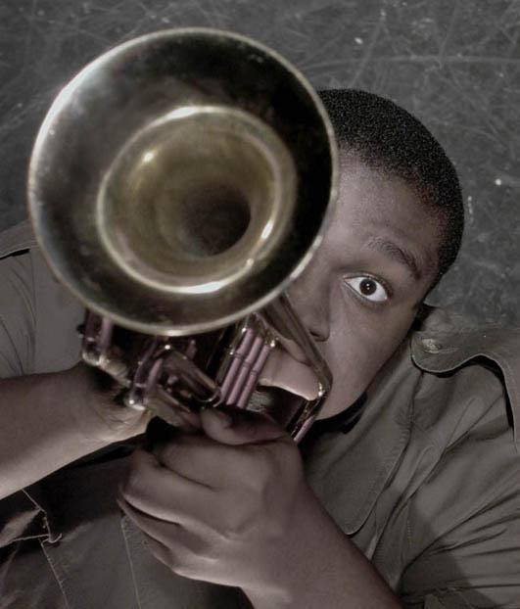
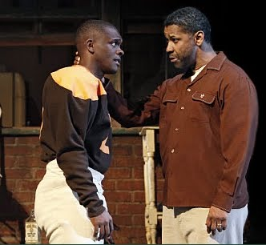
Characters: The Sons
Lyons Maxson
Struggling musician
  Relies on Bonnie
  Troy’s pay day
Gambling
  Risk for future
Self confidence
  Gains respect
  Retains humanity
Cory Maxson
Football
  White mans game
  Chance for life
Respectful
  Compassionate
  Patient
Ambitions
  Bright future
  Determined
  Unafraid to dream big

Slide 12
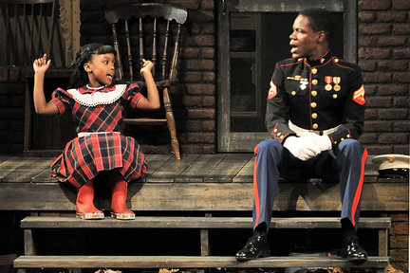
Characters: Raynell Maxson
Troy & Alberta’s illegitimate child
Innocence
  Rose forgives Troy
  Rose raises Raynell
Spared from Troy’s ideals
  Representing new hope for the future
  Positive values
Helps patch Cory & Troy’s relationship

Slide 13
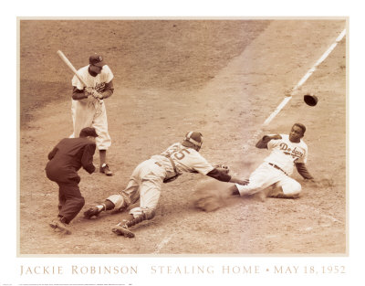
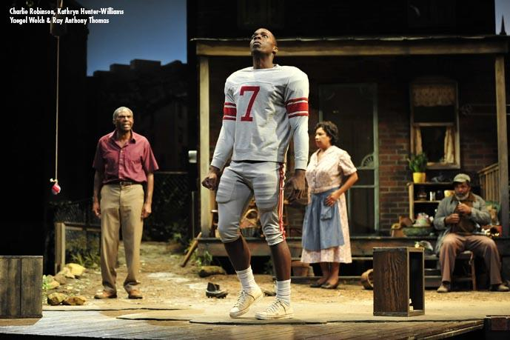
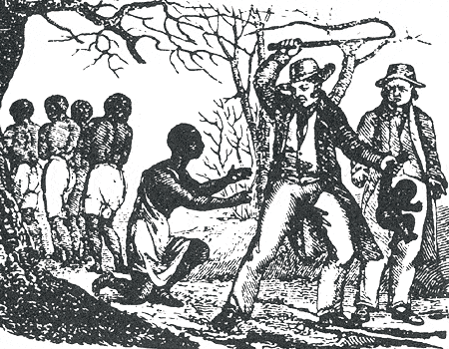
Themes & Analysis
“Swinging for the fences”
Dreams for self vs Dreams for the family
Perception of History
Heritage

Slide 14
Fences is a modern work because it...
is authentic in both dialogue and setting
asks more questions than gives answers
(specifically about morality, and institutions)
has disaster caused by the characters themselves rather than some higher power
emphasises character rather than plot
seeks to order the disorder

Slide 15
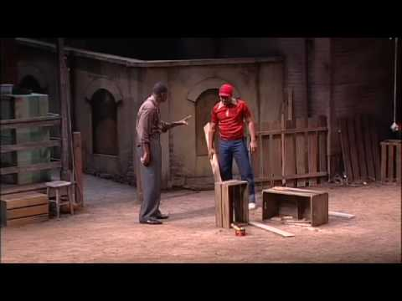
For your viewing pleasure

Slide 16
For further enjoyment: More Plays by August Wilson
Plays:
1904 - Gem of the Ocean
1911 - Joe Turner's Come and Gone
1927 - Ma Rainey's Black Bottom
1936 - The Piano Lesson
1948 - Seven Guitars
1957 - Fences
1969 - Two Trains Running
1977 - Jitney
1985 - King Hedley II
1997 - Radio Golf

